Slide 1


How to access Classlink email and teams

Slide 2
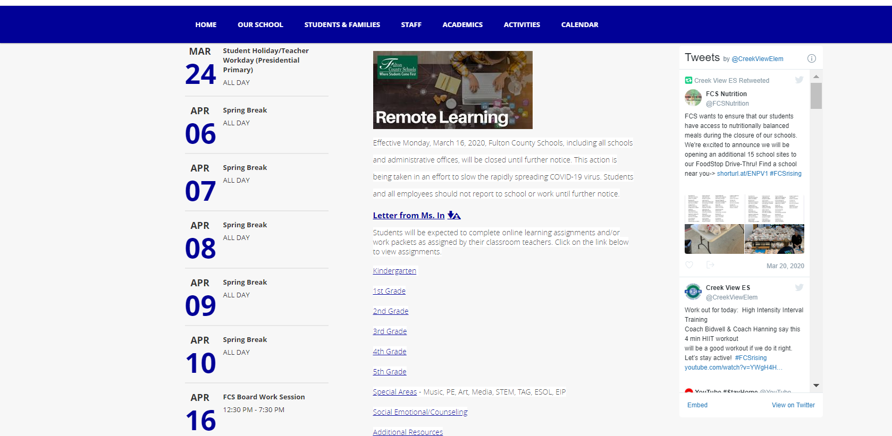
Remote Learning Resources
Each grade has it's own webpage.

Slide 3
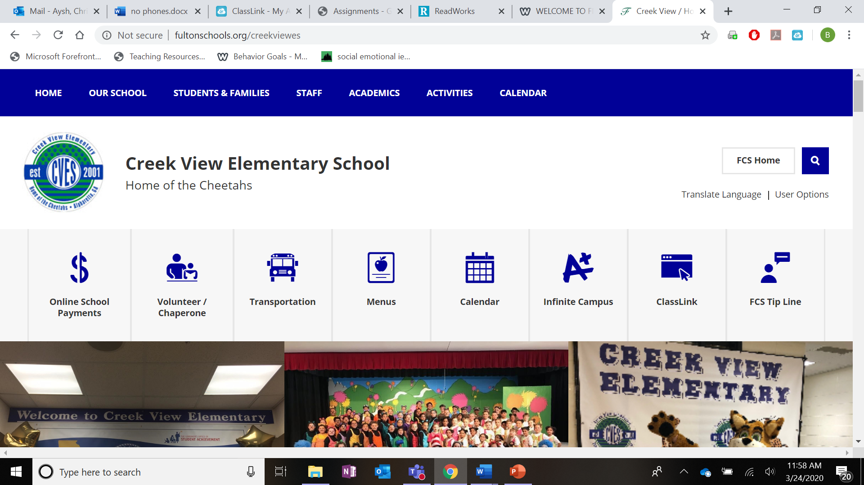
ClassLink
To access Fulton County Apps, students need to click on the ClassLink app and login to the Fulton County Portal

Slide 4
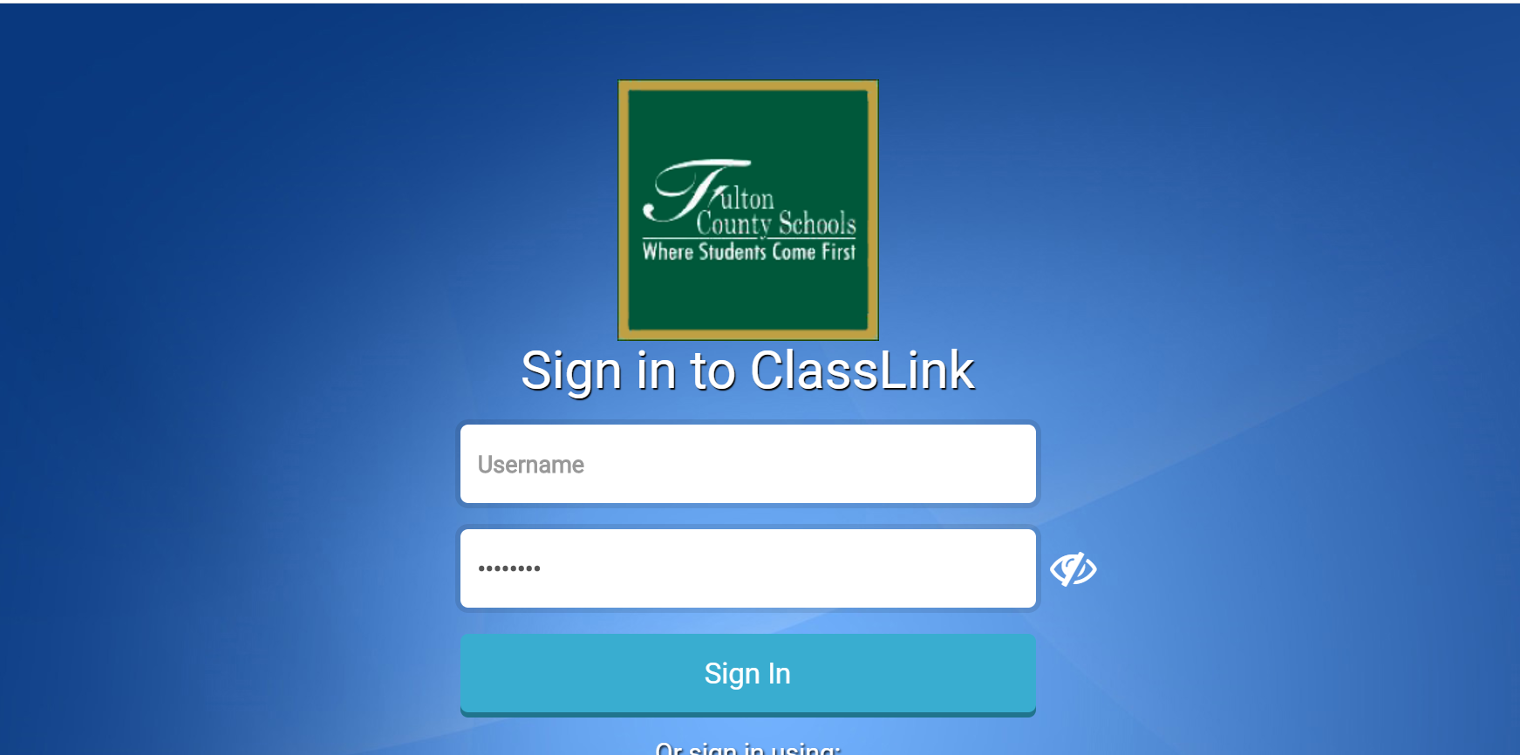
To access anything from the county, you will need to login to the launchpad through Classlink.

Slide 5
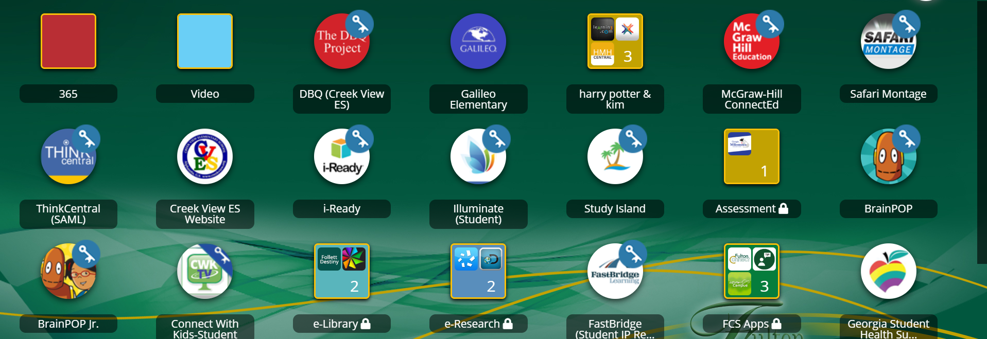
Here you can access Brain Pop, I-Ready, McGraw Hill (math, science texts), Illuminate, Safari Montage,Office 365 (email, Teams)

Slide 6
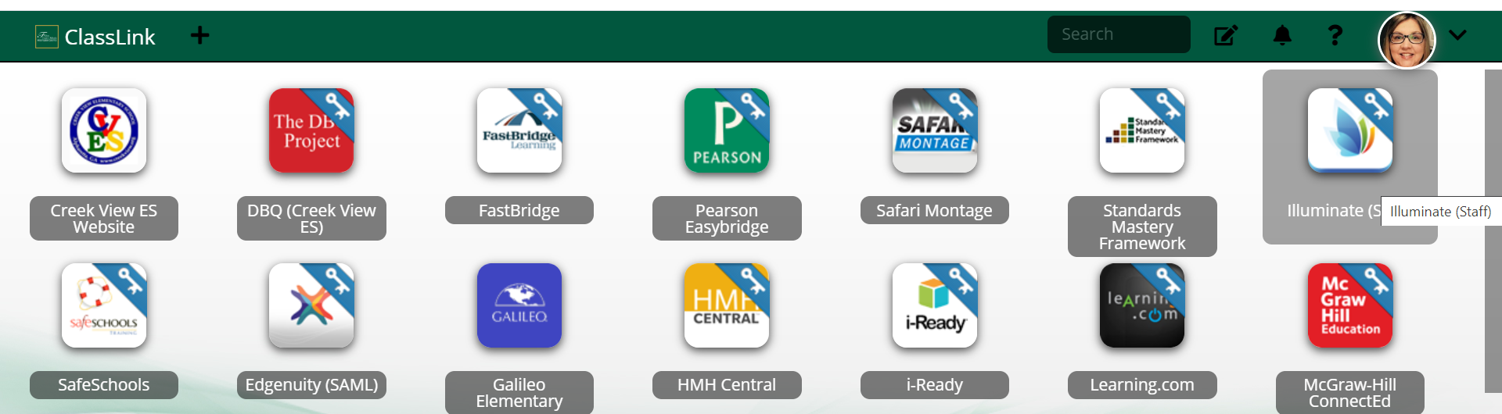
Safari Montage-you can watch all sorts of educational videos

Slide 7
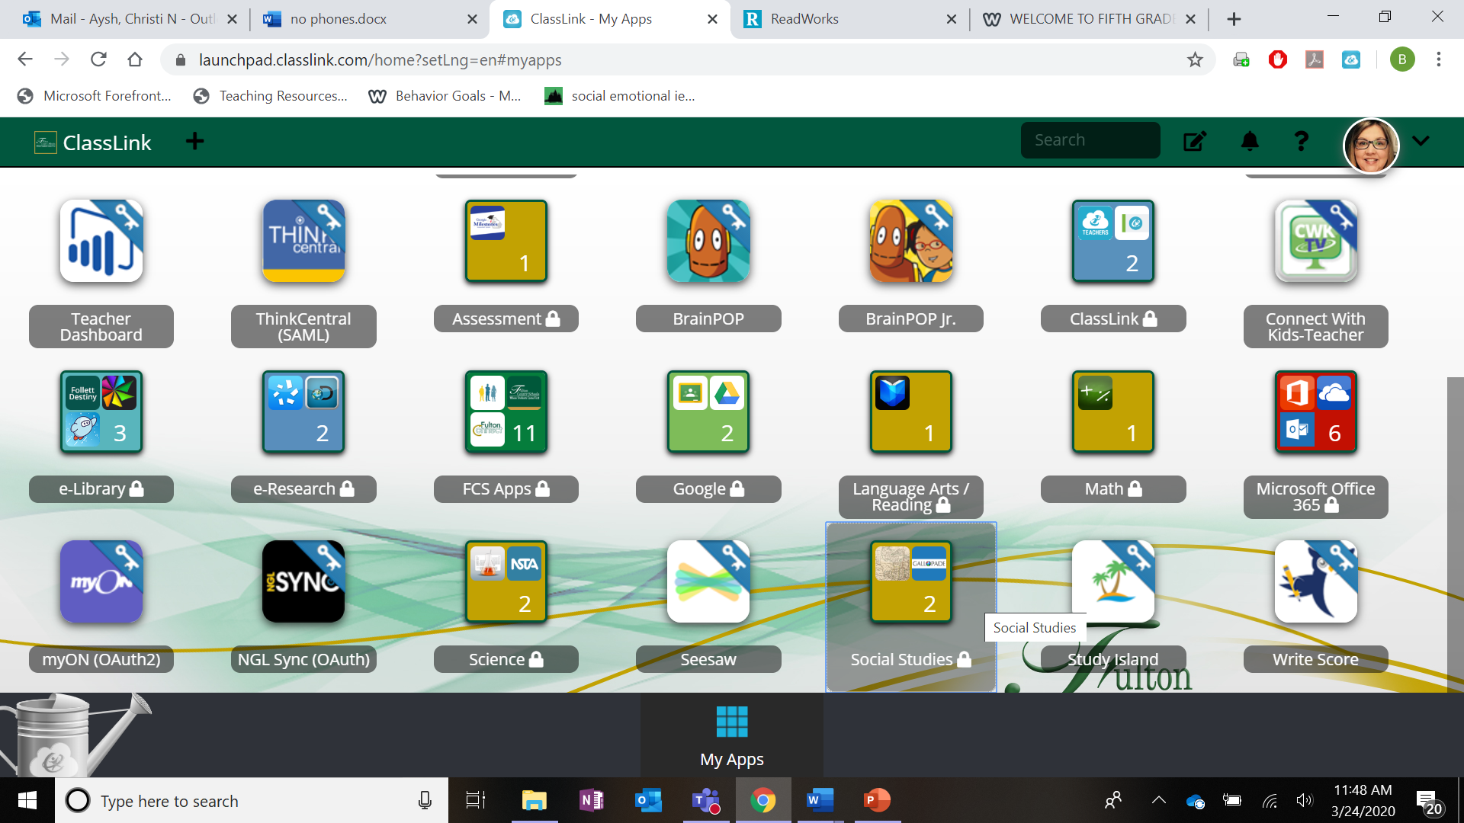
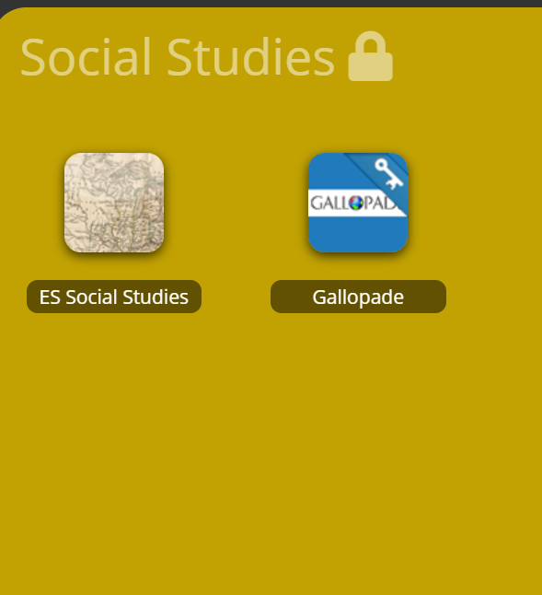
Gallopade-SS Resource

Slide 8
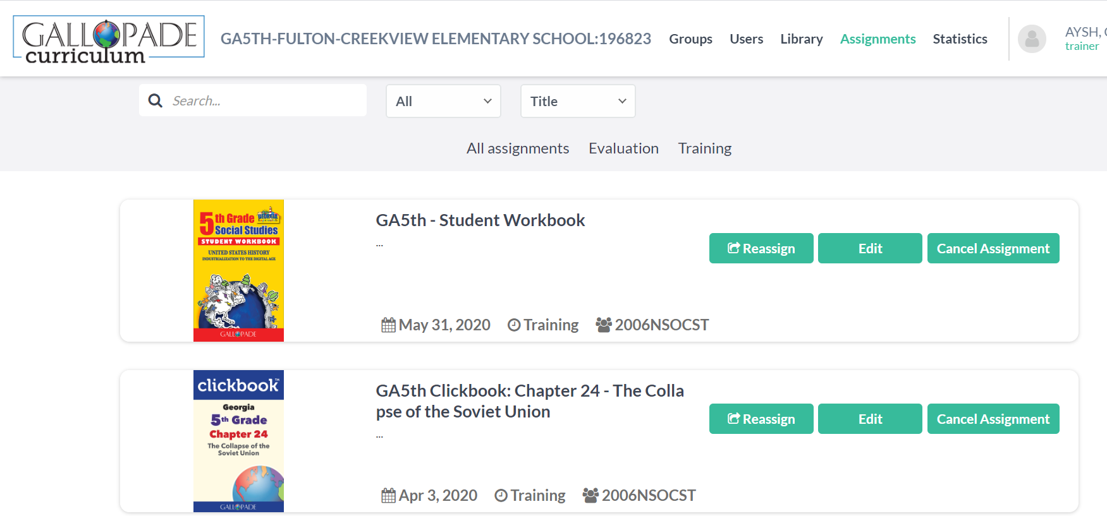
The tool bar will have your assignments

Slide 9
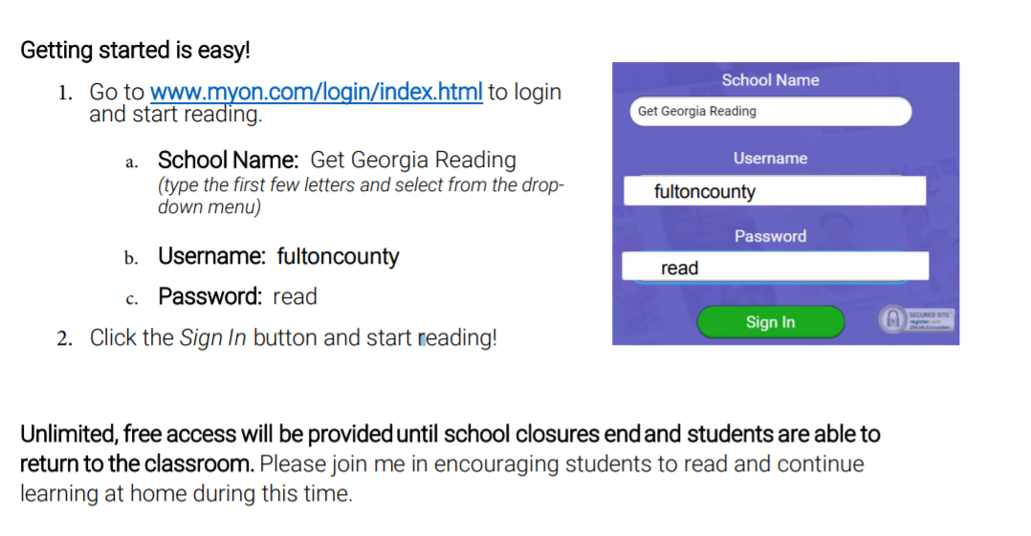
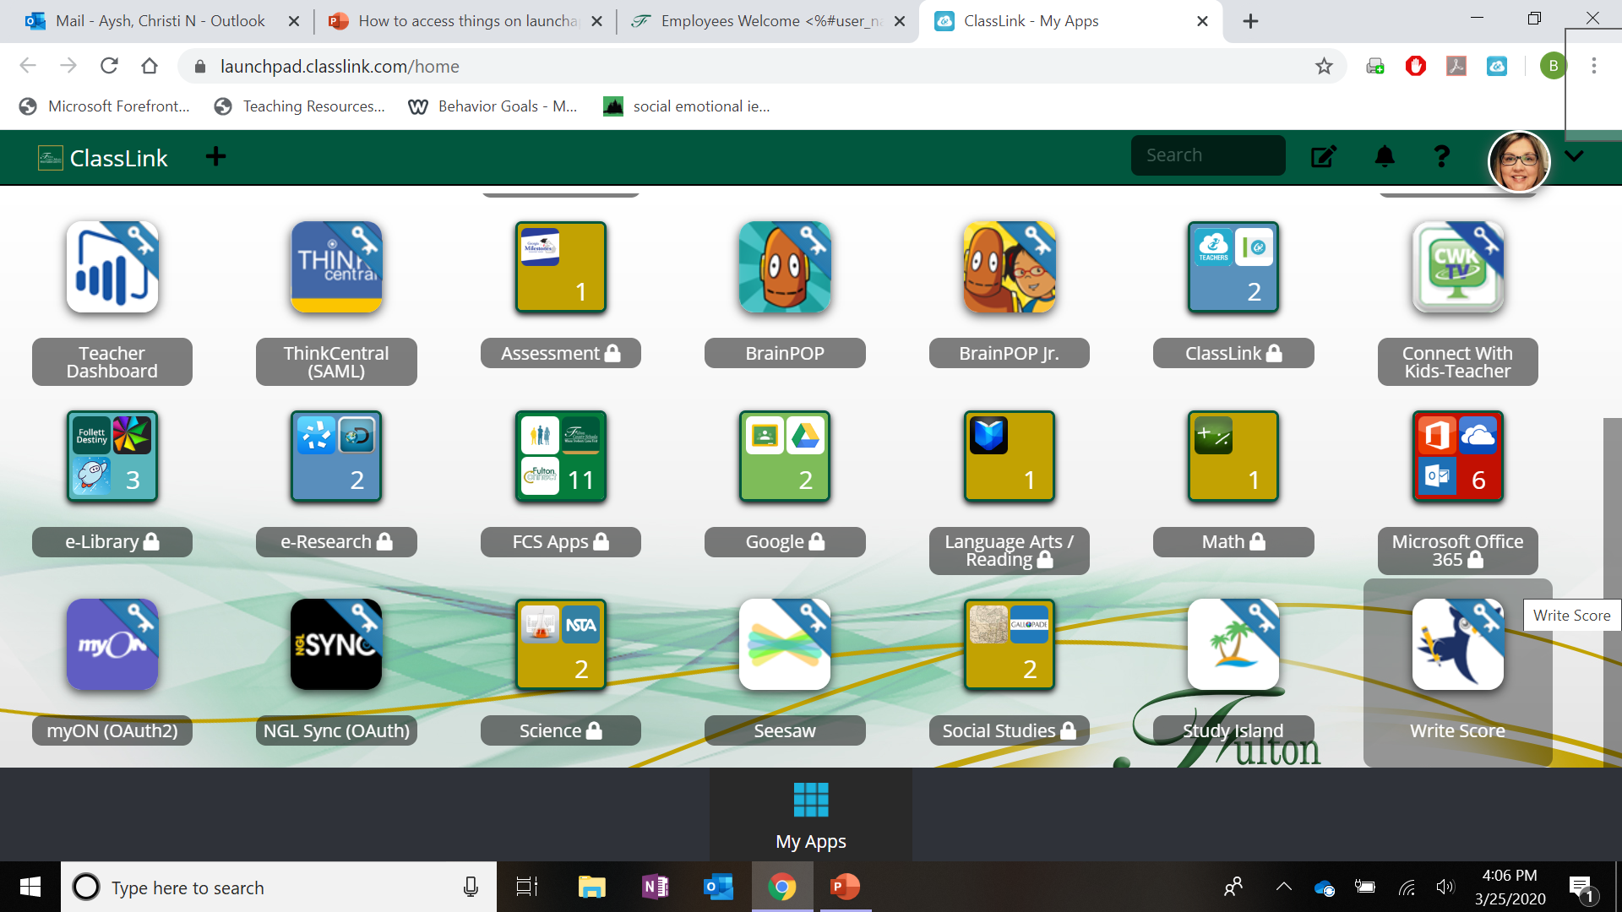
MyOn can be accessed through ClassLink or below

Slide 10
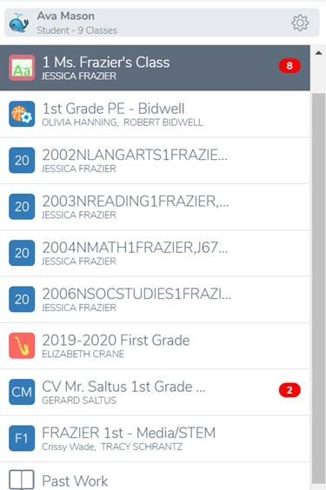
Seesaw can be accessed through ClassLink and your student's class will pop up on the side.

Slide 11

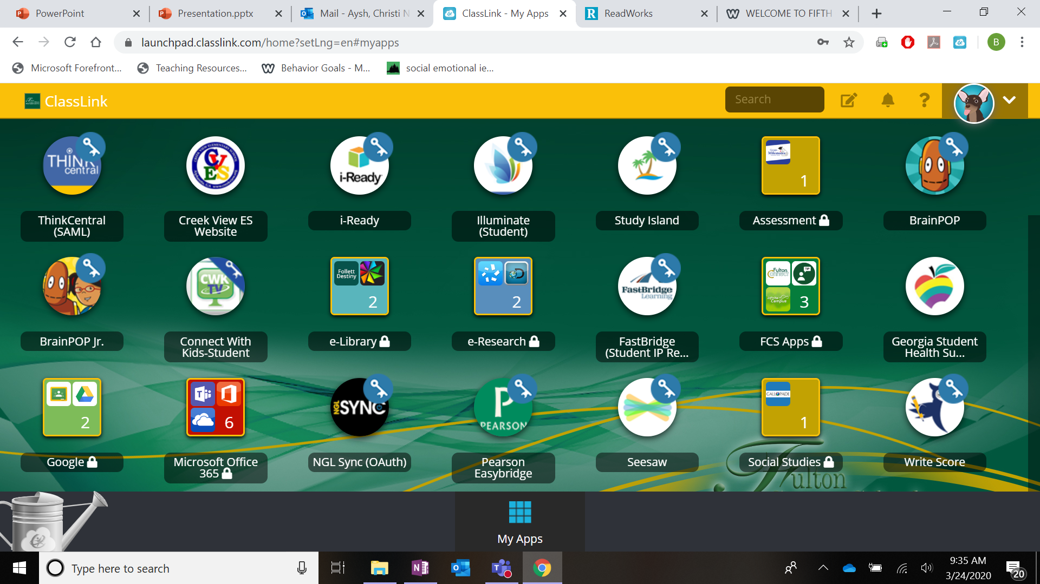
Now We will look at Office 365

Slide 12
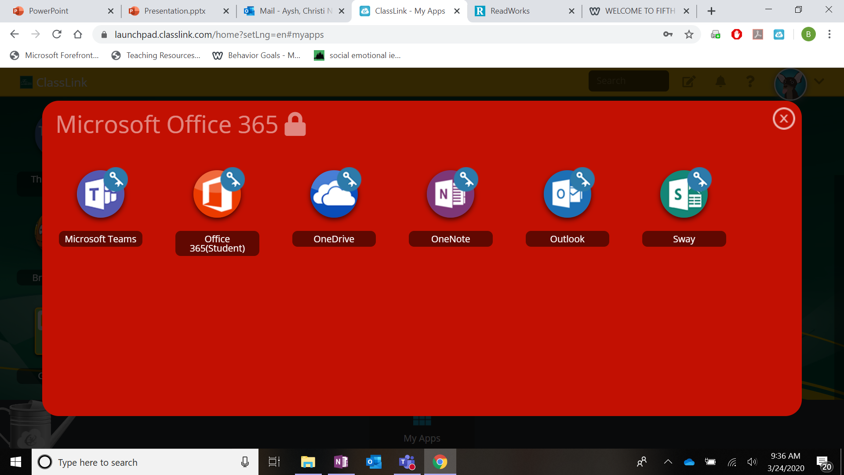
Teams-access teacher pages
Office-everything
One Drive-saved documents
One Note-not used now
Outlook-email
Sway-create
presentations

Slide 13
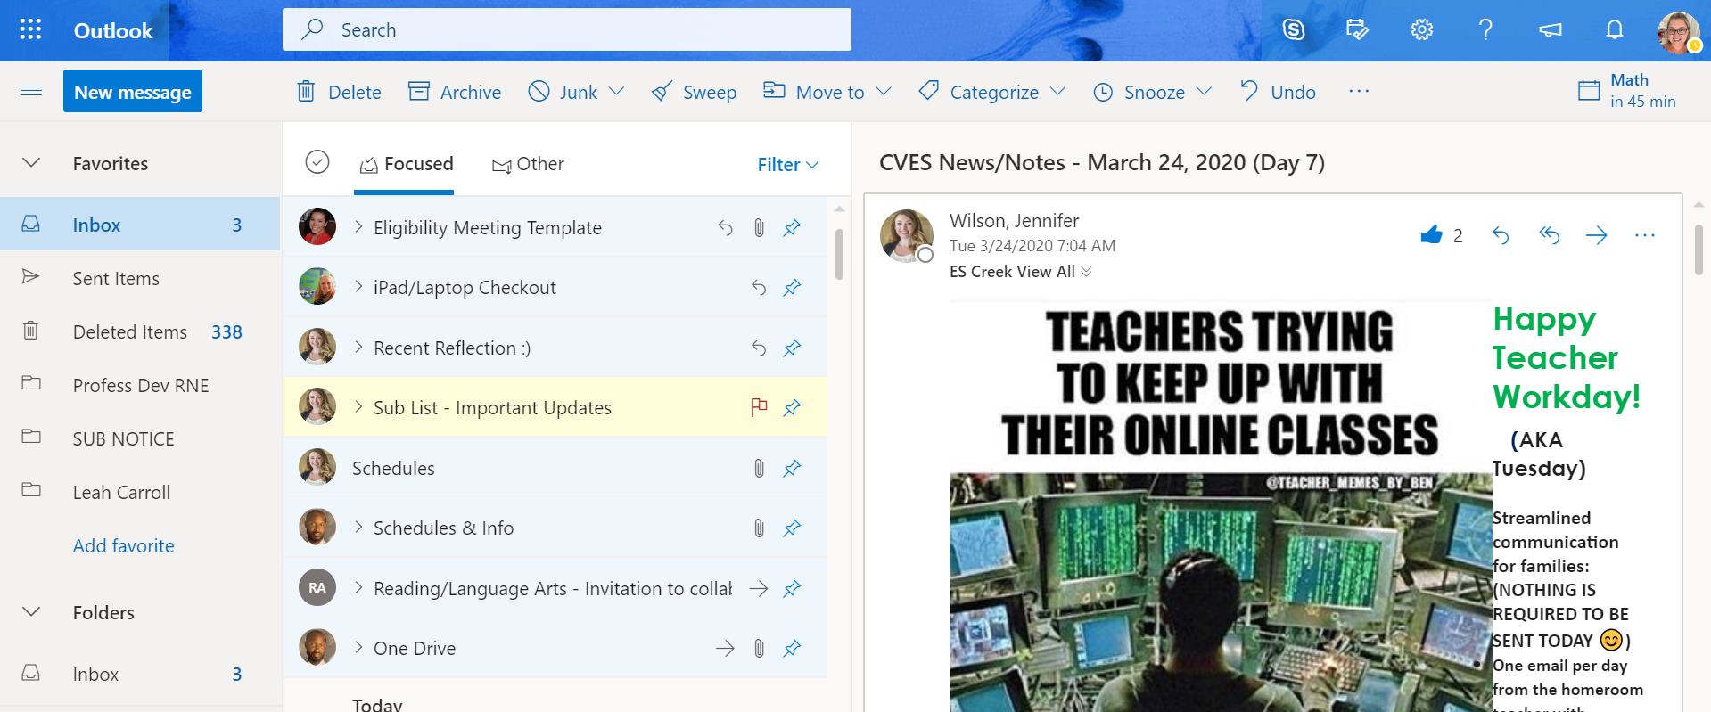
Outlook-email-Teachers can email students and Students can email teachers :)

Slide 14
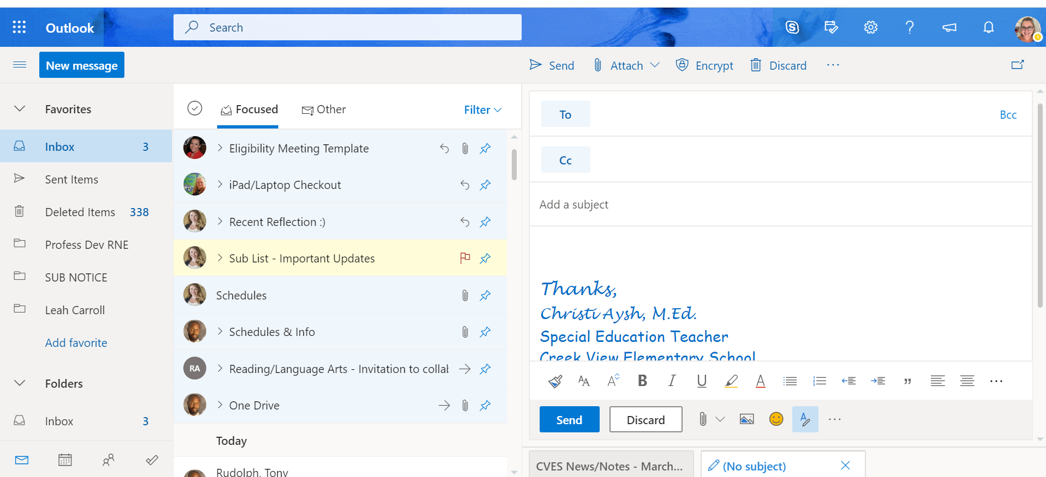
Click on new message. To email a teacher, type their last name in the TO section. When their name appears, click on it.
Your emails appear in your inbox. Blue means unread or unopened.

Slide 15
Teams-access teacher pages
Office-everything
One Drive-saved documents
One Note-not used now
Outlook-email
Sway-create
presentations

Slide 16
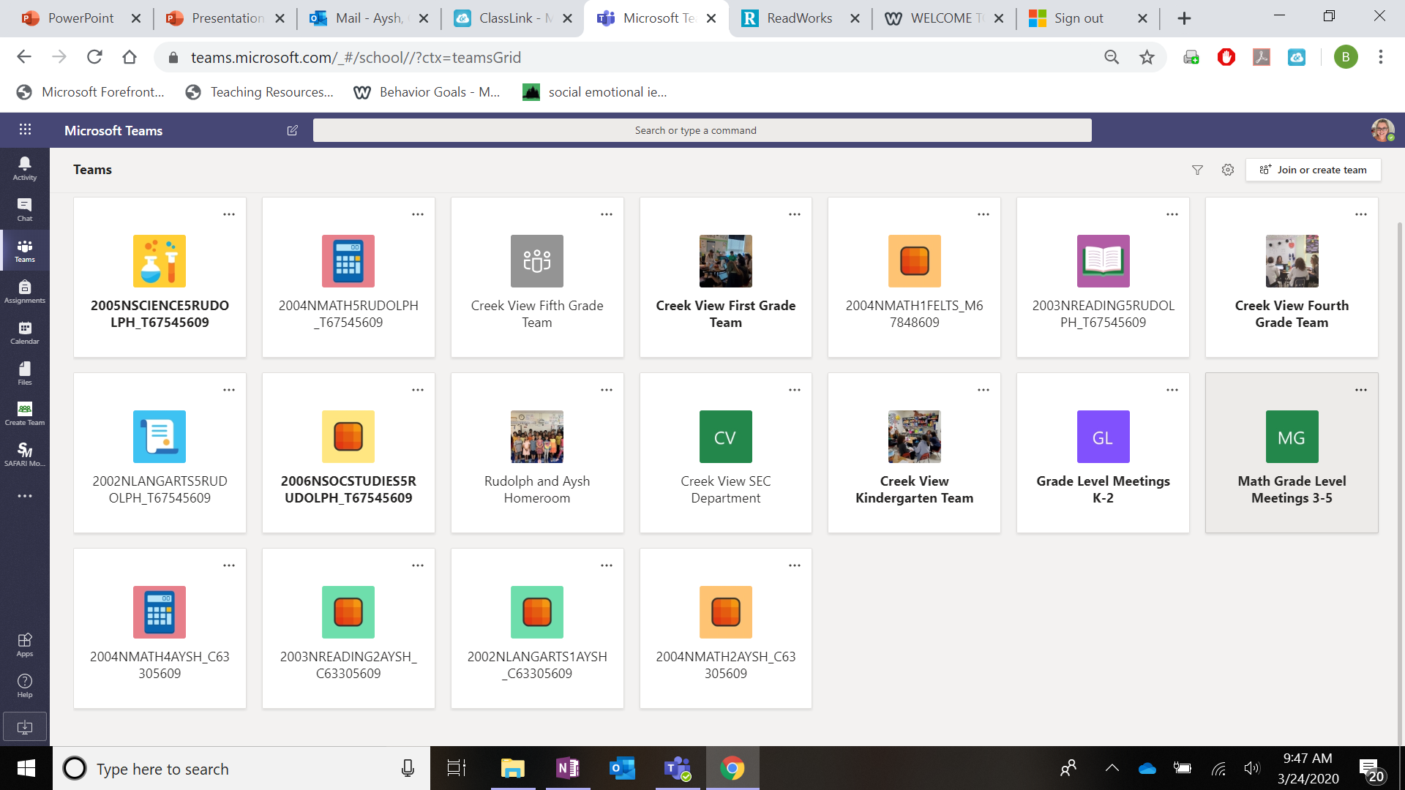
Teams-each class (Reading, Writing, Math, Science, Social Studies) has a teamS page

Slide 17
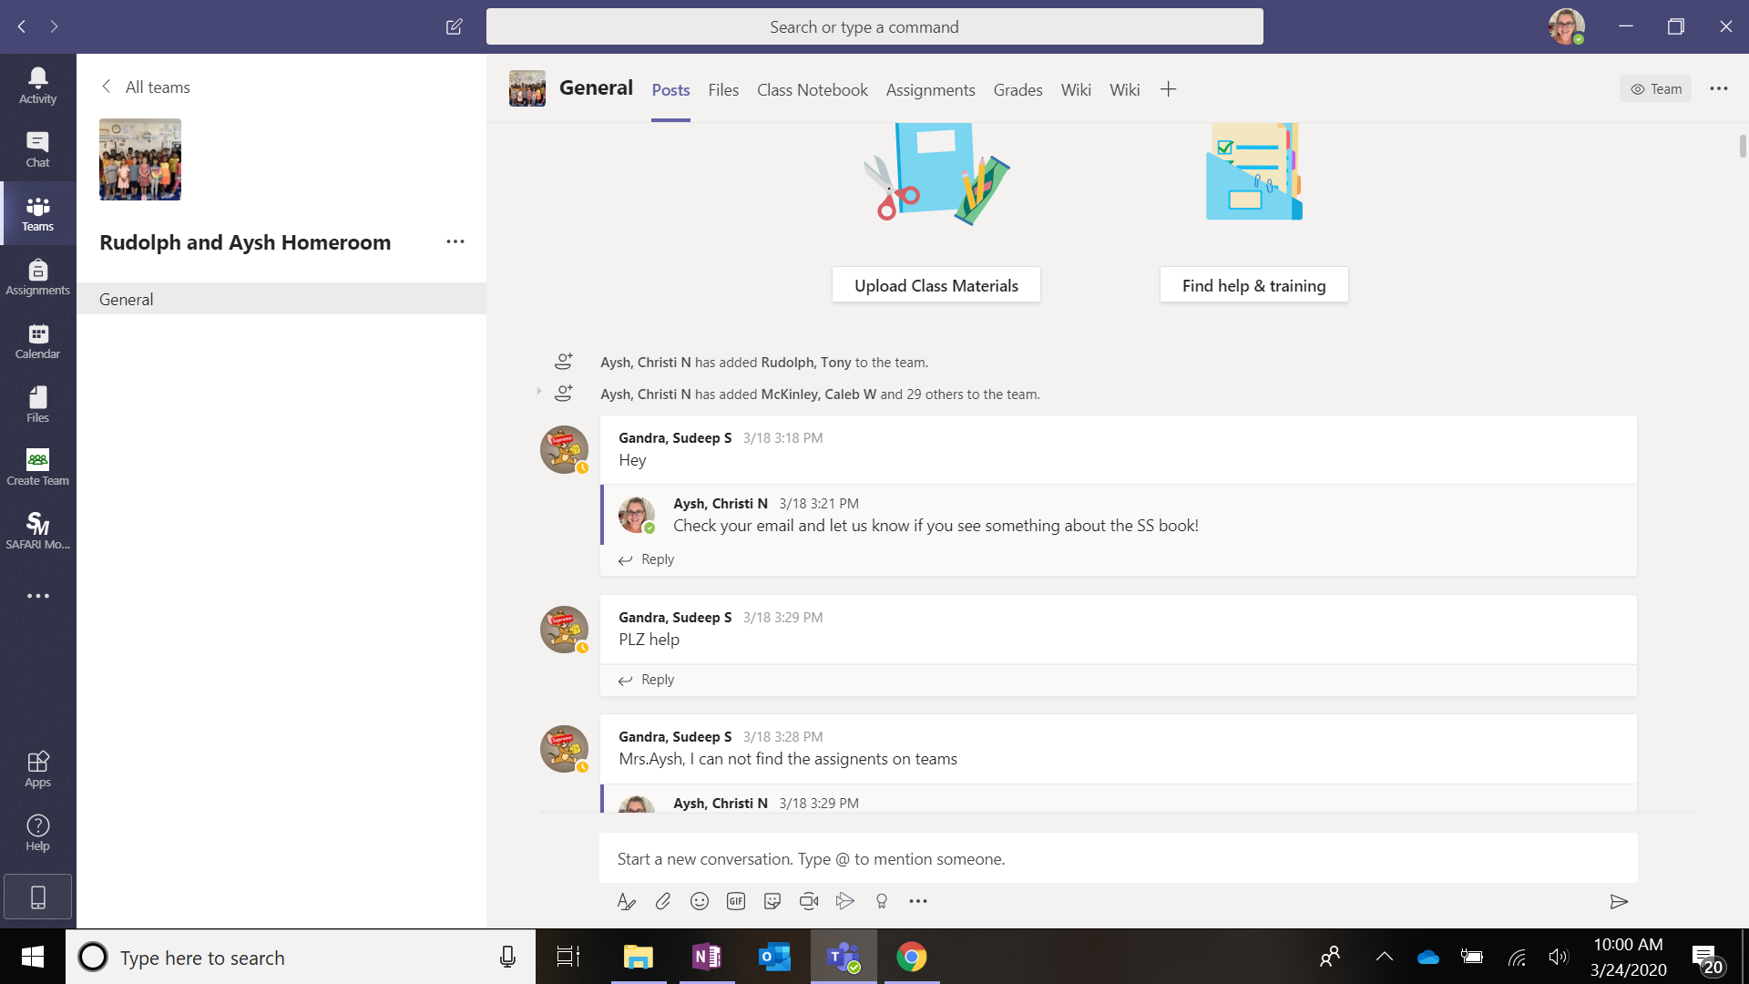
The top says General-Posts, Files, Notebooks
We will use the Posts and Files section mostly
Post-your questions/Hello/ comments
*LIke a chat :)
Files-Things your teacher has uploaded for you

Slide 18
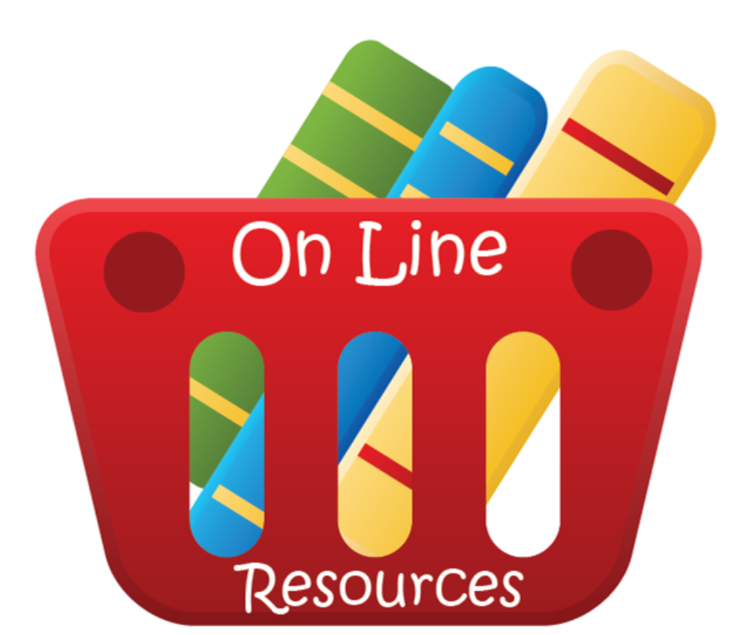
Other resources your teacher might use…
This Photo by Unknown Author is licensed under CC BY-NC-ND

Slide 19

LearnZillion
Follow the steps below to join your Learn Zillion class
1.Go to learnzillion.com
2. Click “Sign Up”
3. Enter your student’s enrollment code in the search bar at the top of the page. (Homeroom teachers have sent this out via email for grades that use this resource)
4. Create a username and password- As a suggestion, have students use their ClassLink username and password since they are familiar with it.
5. Please have them write down login information to remember in the future.

Slide 20
Scholastic Books
Link to website
Select the grade level you need and follow the prompts! :)

